Slide 1
Rainfall Prediction Project
Ebrahim Shahid
Omercan Devran

Slide 2
Objectives
1.Predict weather using fuzzy logic 2.Create accurate prediction using data sets which are provided 3.Test program via dummy input and match output with reality 4.Import a dataset to MatLab to use for analysis 5.Implement the fuzzy logic toolbox to obtain forecast of rainfall

Slide 3
Our Project
Purpose - analyze a weather dataset to give a prediction of likelihood of rain as a percentage using Fuzzy Logic
Will it rain today? is not a YES/NO answer so we use fuzzy logic and % to answer

Slide 4
Our Project
Our prediction is obtained by using the Fuzzy Logic Toolbox in Matlab and using a dataset of weather data provided by MeteoBlue.com.
We have fuzzified our data with the min and max values of each input value such as: Temperature, Wind Speed, Humidity, Sea Level Pressure, and Cloudiness.
MatLab then uses the Fuzzy Logic Triangular Membership function to obtain the result as a percentage.

Slide 5
Dataset
We have used MeteoBlue History+ dataset which was exported to Excel as a CSV file

Slide 6
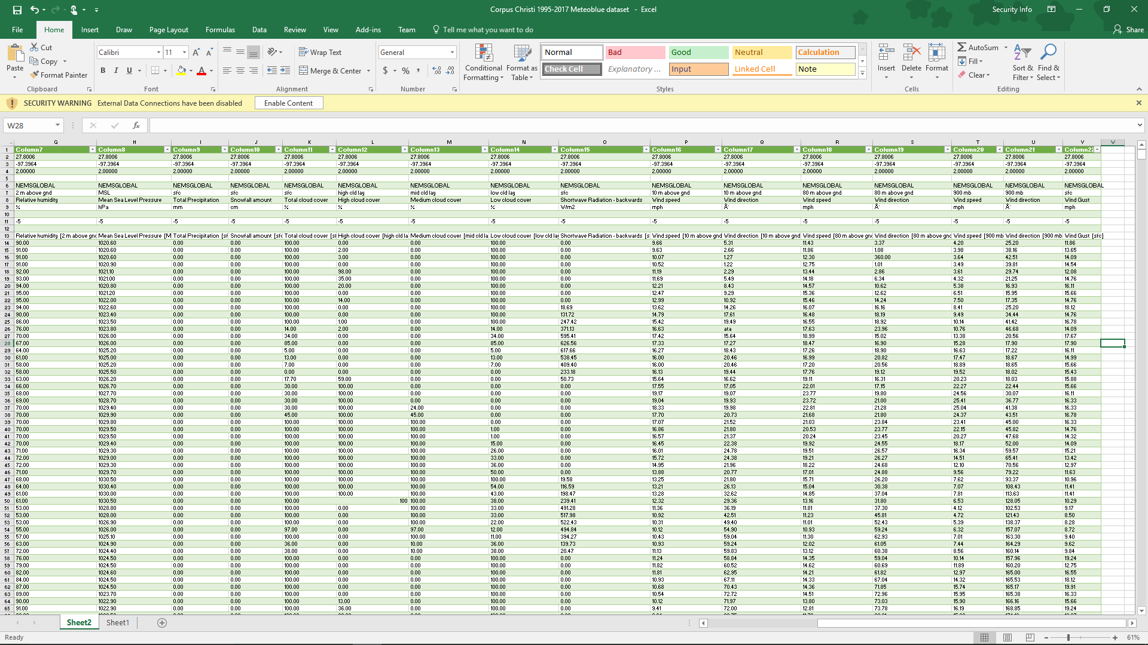
Dataset

Slide 7
Input Domain
These are our inputs:
Temperature (Fahrenheit)
Humidity (%)
Windspeed (mph)
Cloudiness (%)
Air pressure (10m up)

Slide 8
Model
Fuzzy Logic
The specific model we chose was the Triangular Membership Function Model

Slide 9
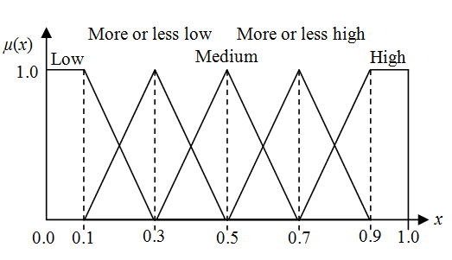
Model

Slide 10
Evaluation Criteria
These are other models that have been used for rainfall prediction in the past
Linear Regression
Exponential Smoothing
Neural Fuzzy Inference Systems

Slide 11
Observations
Our program worked as we wanted and planned
We were able to find right input, use it , and get a output using fuzzy logic
Rainfall is never crisp, it is always fuzzy

Slide 12
Observations
We could also use neural networks to also get a prediction on rainfall but we decided to work with fuzzy logic because, end-user can only answer couple survey-like questions to get quick answer without hassle of putting numbers.
Our point of view, fuzzy logic is the best way to implement on weather prediction.

Slide 13
Code
clear all,
clc,
close all;
f=readfis('RainfallPredictor.fis')
a=input('What is the temperature (in Fahrenheit (0-120 degrees) 0=Very Cold, 30=Cold, 60=Normal, 90=Hot, 120=Very Hot ) ? =');
b=input('How much is the humidity percentage ? (1-100, -1 is super dry, 100 very sticky ,60 feels normal)');
c=input('What is the current pressure (From 990 to 1040 Bars,Normally it is around 1020)? =');
d=input('How cloudy is it ?(0-10, 0 is clear sky ,3 few clouds, 5 some clouds, 8 many clouds, 10 is dark sky)');
e=input('How fast is the wind (0-40 Mph ,0 No wind, 5 Breeze, 15 windy, 25 Strong Wind, 40 Very Strong Wind ) ? =');
g=evalfis([a b c d e ], f);
disp(['Rainfall Prediction : %',num2str(g)])

Slide 14
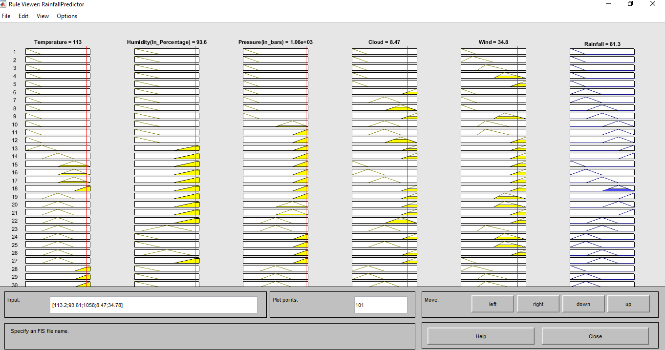
Screenshots

Slide 15
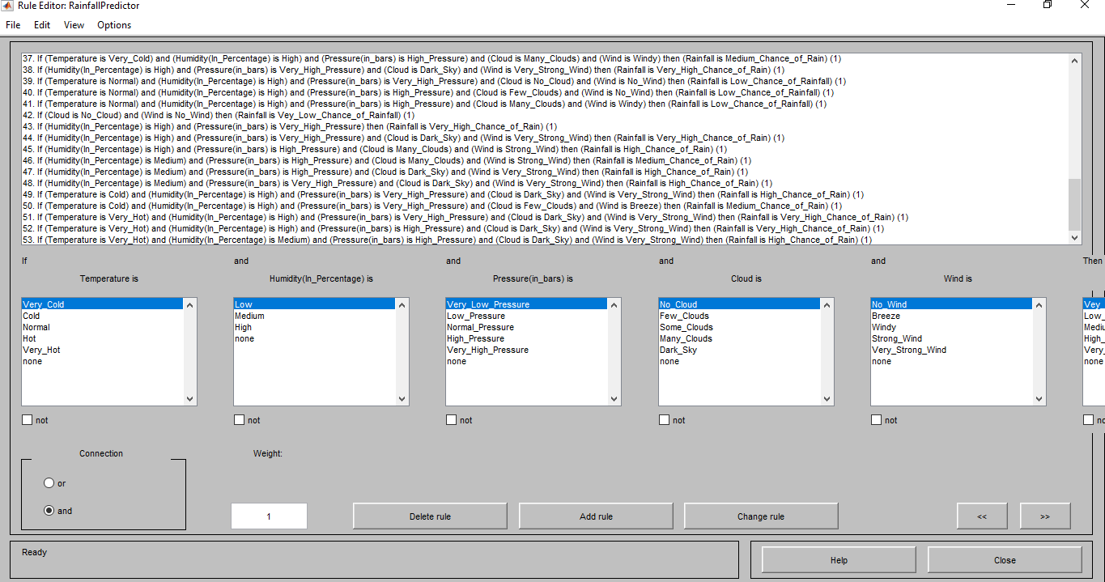
Screenshots

Slide 16
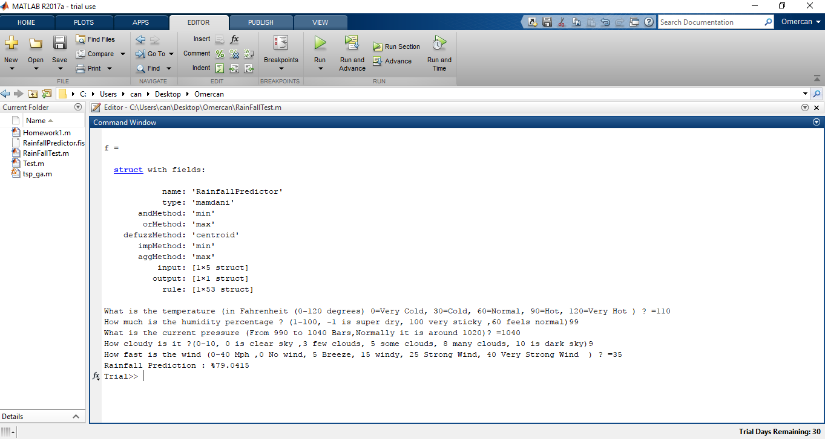
Screenshots

Slide 17
Conclusion
We added attributes to matlab and process them using fuzzy logic toolbox.
We set rules in order to get rainfall percentage.
Attributes have fuzzy values like very high,high,medium,low and very low
After we enter input for attributes we are able to find out rainfall prediction .

Slide 18
Future Work
With the knowledge of being able to predict chance of rain on a dataset we can further into weather alert programming:
Flood warning
Tornado Warning
Hurricane Warning
City Evacuation Warning if there is extreme weather

Slide 19
References
Neural Fuzzy Inference System-Based Weather Prediction Model and Its Precipitation Predicting Experiment by Jing Lu, Shengjun Xue , Xiakun Zhang , Shuyu Zhang , and Wanshun Lu MATLAB Fuzzy Logic Toolbox Climate Change Knowledge Portal http://www.nws.noaa.gov/ndfd/ Climate Change Knowledge Portal at WorldBank.org http://sdwebx.worldbank.org/climateportal/ https://www.ncei.noaa.gov MeteoBlue.com (for Dataset) https://www.youtube.com/watch?v=h-PekWwPR-k&ab_channel=RohitSalgotra

